Slide 1
Enabling Full Transactional Privacy with
1-out-of-N Proofs
Notes:
The decisional Diffie–Hellman (DDH) assumption is a computational hardness assumption about a certain problem involving discrete logarithms in cyclic groups.
In Greek mythology, Lelantus was one of the younger Titanes who was moving unseen

Slide 2
INTRODUCTION
Cryptocurrency payments to be truly private, transactions have to have three properties:
1
2
3
Un-Traceability
hiding the identities of the sender / the transaction origins
Confidentiality,
hiding the transferred amounts
Anonymity
hiding the recipients identity

Slide 3
CRYPTO BACKGROUND: COMMITMENTS
Double-blinded Homomorphic commitments
The ( Generalized )Pedersen commitment scheme
Notes:
The key generation algorithm G outputs a description of a cyclic group G of prime order p and random generators g and h. The commitment key is ck = (G, p, g, h). To commit to m ∈ Zq the committer picks randomness r ∈ Zp and computes Comck(m; r) = gm · hr
The Pedersen commitment scheme can be generalized for multiple messages, i.e. given messages m1, m2, ..., mn one can create a single commitment of the form Com(m1, m2, · · · mn; r) = h r g m1 1 g m2 2 · · · g mn .

Slide 4
Coins As Double-blinded Commitments
Coins are double blinded commitments:
$S$ is unique coin serial number which is revealed during SPEND
$V$ is the coin hidden value (within a range [$0, 2^{64}−1$))
$R$ is the random blinding factor. It prevents identification of the coin after S is revealed (as V can be easily brute forced)
Notes:
The key generation algorithm G outputs a description of a cyclic group G of prime order p and random generators g and h. The commitment key is ck = (G, p, g, h). To commit to m ∈ Zq the committer picks randomness r ∈ Zp and computes Comck(m; r) = gm · hr
The Pedersen commitment scheme can be generalized for multiple messages, i.e. given messages m1, m2, ..., mn one can create a single commitment of the form Com(m1, m2, · · · mn; r) = h r g m1 1 g m2 2 · · · g mn .

Slide 5
Transactions Hiding the Values and Origins
We assume each transaction can spend $N_{old}$coins and output $N_{new}$coins
1. $N_{old}$Input Coins:
2. $N_new$ Output Coins:
Notes:
The key generation algorithm G outputs a description of a cyclic group G of prime order p and random generators g and h. The commitment key is ck = (G, p, g, h). To commit to m ∈ Zq the committer picks randomness r ∈ Zp and computes Comck(m; r) = gm · hr
The Pedersen commitment scheme can be generalized for multiple messages, i.e. given messages m1, m2, ..., mn one can create a single commitment of the form Com(m1, m2, · · · mn; r) = h r g m1 1 g m2 2 · · · g mn .

Slide 6
Enabling Full Transactional Privacy
Transaction owner should PROVE that
1. All Input Spends are valid without revealing their origins (Via 1-out-of-N Proofs)
2. Balance is preserved without revealing any input or output coin value
3. No Output Coin contains a negative value ( Bulletproofs)
4. Output Coins can be spent only by the intended recipients
Notes:
The key generation algorithm G outputs a description of a cyclic group G of prime order p and random generators g and h. The commitment key is ck = (G, p, g, h). To commit to m ∈ Zq the committer picks randomness r ∈ Zp and computes Comck(m; r) = gm · hr
The Pedersen commitment scheme can be generalized for multiple messages, i.e. given messages m1, m2, ..., mn one can create a single commitment of the form Com(m1, m2, · · · mn; r) = h r g m1 1 g m2 2 · · · g mn .

Slide 7
Proof of Valid Spends via 1-out-of-N Proofs
$$(C_{0}, C_{1},…, C_{N})$$
Initial Set of All Coins is
For each input coin
Prover reveals the coin’s serial number $S$.
Prover parses the initial set of all commitments $(C_{0}, C_{1},…, C_{N})$ and computes $C_{i}= C_{i} ·Comm{\left(S;0,0\right)}^{−1}$
Prover provides a non-interactive 1-oo-N Proof for a double blinded commitment opening to 0 for the new set $\left(C_{0}, C_{1},…, C_{N} \right).$
Notes:
The key generation algorithm G outputs a description of a cyclic group G of prime order p and random generators g and h. The commitment key is ck = (G, p, g, h). To commit to m ∈ Zq the committer picks randomness r ∈ Zp and computes Comck(m; r) = gm · hr
The Pedersen commitment scheme can be generalized for multiple messages, i.e. given messages m1, m2, ..., mn one can create a single commitment of the form Com(m1, m2, · · · mn; r) = h r g m1 1 g m2 2 · · · g mn .

Slide 8
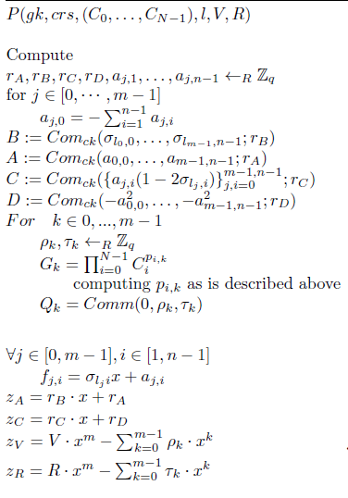
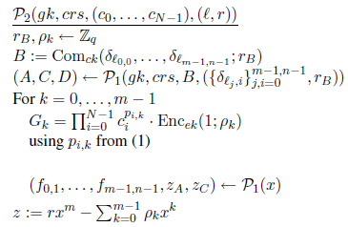
$$Com(0;ρ_{k})$$

Slide 9
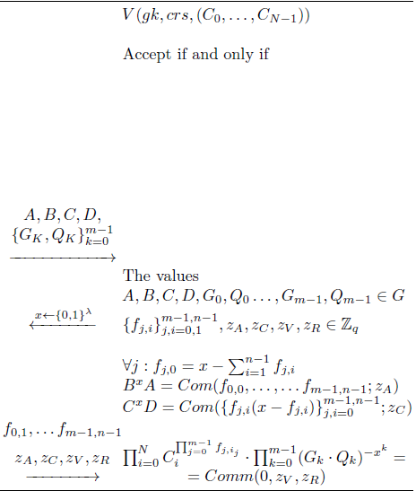

Slide 10
Generating a Balance Proof
Each Transaction published on the blockchain will contain
Transaction Output Coins ( + Range Proofs)
$N_{old}$ Sigma Proofs ( One proof per each Input Coin)
THIS INFORMATION IS ENOUGH TO GENERATE A BALANCE PROOF
Notes:
The key generation algorithm G outputs a description of a cyclic group G of prime order p and random generators g and h. The commitment key is ck = (G, p, g, h). To commit to m ∈ Zq the committer picks randomness r ∈ Zp and computes Comck(m; r) = gm · hr
The Pedersen commitment scheme can be generalized for multiple messages, i.e. given messages m1, m2, ..., mn one can create a single commitment of the form Com(m1, m2, · · · mn; r) = h r g m1 1 g m2 2 · · · g mn .

Slide 11
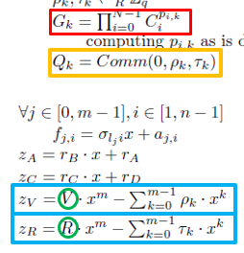
Generating a Balance Proof
$$(C_{O1}, C_{O2},…, C_{ON_{new}})$$
1. Transaction Output Coins
2. The transaction proof transcript contains the following information (taken from the $N_old$ Sigma Proofs)
and
where
and
Notes:
The key generation algorithm G outputs a description of a cyclic group G of prime order p and random generators g and h. The commitment key is ck = (G, p, g, h). To commit to m ∈ Zq the committer picks randomness r ∈ Zp and computes Comck(m; r) = gm · hr
The Pedersen commitment scheme can be generalized for multiple messages, i.e. given messages m1, m2, ..., mn one can create a single commitment of the form Com(m1, m2, · · · mn; r) = h r g m1 1 g m2 2 · · · g mn .

Slide 12
Generating a Balance Proof
Each Verifier can compute the following values
If the balance is preserved then
Prover provides a proof of representation of the value $\frac{A}{B}$ with respect to the generators $g$ and $h_{2}$ (through gen. Schnorr proof of Knowledge?)
Notes:
The key generation algorithm G outputs a description of a cyclic group G of prime order p and random generators g and h. The commitment key is ck = (G, p, g, h). To commit to m ∈ Zq the committer picks randomness r ∈ Zp and computes Comck(m; r) = gm · hr
The Pedersen commitment scheme can be generalized for multiple messages, i.e. given messages m1, m2, ..., mn one can create a single commitment of the form Com(m1, m2, · · · mn; r) = h r g m1 1 g m2 2 · · · g mn .

Slide 13
Generating Balance Proof
Any feedback or comments on balance proof generation method?
Notes:
The key generation algorithm G outputs a description of a cyclic group G of prime order p and random generators g and h. The commitment key is ck = (G, p, g, h). To commit to m ∈ Zq the committer picks randomness r ∈ Zp and computes Comck(m; r) = gm · hr
The Pedersen commitment scheme can be generalized for multiple messages, i.e. given messages m1, m2, ..., mn one can create a single commitment of the form Com(m1, m2, · · · mn; r) = h r g m1 1 g m2 2 · · · g mn .

Slide 14
Batch Verification of 1-o-o-N Proofs
The verification of the t-th 1-o-o-N Proof boils down to a big multi-exponentiation
Notes:
The key generation algorithm G outputs a description of a cyclic group G of prime order p and random generators g and h. The commitment key is ck = (G, p, g, h). To commit to m ∈ Zq the committer picks randomness r ∈ Zp and computes Comck(m; r) = gm · hr
The Pedersen commitment scheme can be generalized for multiple messages, i.e. given messages m1, m2, ..., mn one can create a single commitment of the form Com(m1, m2, · · · mn; r) = h r g m1 1 g m2 2 · · · g mn .

Slide 15
Batch Verification of 1-o-o-N Proofs
The verification of the t-th 1-o-o-N Proof boils down to a big multi-exponentiation
Which can be written as
where
Notes:
The key generation algorithm G outputs a description of a cyclic group G of prime order p and random generators g and h. The commitment key is ck = (G, p, g, h). To commit to m ∈ Zq the committer picks randomness r ∈ Zp and computes Comck(m; r) = gm · hr
The Pedersen commitment scheme can be generalized for multiple messages, i.e. given messages m1, m2, ..., mn one can create a single commitment of the form Com(m1, m2, · · · mn; r) = h r g m1 1 g m2 2 · · · g mn .

Slide 16
Batch Verification of 1-o-o-N Proofs
The verification of the t-th 1-o-o-N Proof boils down to a big multi-exponentiation
Which can be written as
In the Zerocoin setup, the generators are transaction specific:
where
Notes:
The key generation algorithm G outputs a description of a cyclic group G of prime order p and random generators g and h. The commitment key is ck = (G, p, g, h). To commit to m ∈ Zq the committer picks randomness r ∈ Zp and computes Comck(m; r) = gm · hr
The Pedersen commitment scheme can be generalized for multiple messages, i.e. given messages m1, m2, ..., mn one can create a single commitment of the form Com(m1, m2, · · · mn; r) = h r g m1 1 g m2 2 · · · g mn .

Slide 17
Batch Verification of 1-o-o-N Proofs
As we have
Now all N generators are transaction agnostic
E$ach s_{t}$ is explicitly revealed during the SPEND,
The verifier can equivalently check the following equivalency.
Notes:
The key generation algorithm G outputs a description of a cyclic group G of prime order p and random generators g and h. The commitment key is ck = (G, p, g, h). To commit to m ∈ Zq the committer picks randomness r ∈ Zp and computes Comck(m; r) = gm · hr
The Pedersen commitment scheme can be generalized for multiple messages, i.e. given messages m1, m2, ..., mn one can create a single commitment of the form Com(m1, m2, · · · mn; r) = h r g m1 1 g m2 2 · · · g mn .

Slide 18
Batch Verification of 1-o-o-N Proofs
For verifying M different spend proofs in batch, the verifier
Generates $M$ random values $(y_{1}, ….y_{M})$
Computes
Or alternatively
We can save N exponentiation for each extra proof.
Notes:
The key generation algorithm G outputs a description of a cyclic group G of prime order p and random generators g and h. The commitment key is ck = (G, p, g, h). To commit to m ∈ Zq the committer picks randomness r ∈ Zp and computes Comck(m; r) = gm · hr
The Pedersen commitment scheme can be generalized for multiple messages, i.e. given messages m1, m2, ..., mn one can create a single commitment of the form Com(m1, m2, · · · mn; r) = h r g m1 1 g m2 2 · · · g mn .

Slide 19
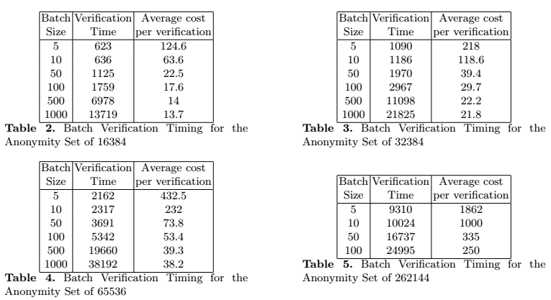
Batch Verification Performance
Notes:
The key generation algorithm G outputs a description of a cyclic group G of prime order p and random generators g and h. The commitment key is ck = (G, p, g, h). To commit to m ∈ Zq the committer picks randomness r ∈ Zp and computes Comck(m; r) = gm · hr
The Pedersen commitment scheme can be generalized for multiple messages, i.e. given messages m1, m2, ..., mn one can create a single commitment of the form Com(m1, m2, · · · mn; r) = h r g m1 1 g m2 2 · · · g mn .

Slide 20
Batch Verification of 1-o-o-N Proofs
Any feedback or comments on how we can improve these batching methods? ☺
Notes:
The key generation algorithm G outputs a description of a cyclic group G of prime order p and random generators g and h. The commitment key is ck = (G, p, g, h). To commit to m ∈ Zq the committer picks randomness r ∈ Zp and computes Comck(m; r) = gm · hr
The Pedersen commitment scheme can be generalized for multiple messages, i.e. given messages m1, m2, ..., mn one can create a single commitment of the form Com(m1, m2, · · · mn; r) = h r g m1 1 g m2 2 · · · g mn .

Slide 21
Enabling Direct Anonymous Payments
In order to spend a coin $C=g^{S}h_{1}^{V}h_{2}^{R}$ , the user should possess all secret values $S, V,R$.
The receiver can generate new public key ${g_{1}=g}^{x}$
The Sender outputs the new coin as $C={(g^{x})}^{S}h_{1}^{V}h_{2}^{R}=g_{1}^{S}h_{1}^{V}h_{2}^{R}$along with the public key $g_{1}$
Only the recipient possessing the secret value $x$ can spend the coin $C={(g^{x})}^{S}h_{1}^{V}h_{2}^{R}=g_{ }^{x.S}h_{1}^{V}h_{2}^{R}$
as only he knows the coin’s real serial number $x∙S$.
Notes:
The key generation algorithm G outputs a description of a cyclic group G of prime order p and random generators g and h. The commitment key is ck = (G, p, g, h). To commit to m ∈ Zq the committer picks randomness r ∈ Zp and computes Comck(m; r) = gm · hr
The Pedersen commitment scheme can be generalized for multiple messages, i.e. given messages m1, m2, ..., mn one can create a single commitment of the form Com(m1, m2, · · · mn; r) = h r g m1 1 g m2 2 · · · g mn .

Slide 22
Enabling Direct Anonymous Payments
In the balance proof generation phase, we will end up having more complex representation of A/B.
( Instead of )
For completing the balance proof, the Prover should provide a proof of representation of the value $\frac{A}{B}$ with respect to the generators $(g_{1}, g_{2}, g_{N_{new}}, h_{2})$ (what is the best way to do this?)
Notes:
The key generation algorithm G outputs a description of a cyclic group G of prime order p and random generators g and h. The commitment key is ck = (G, p, g, h). To commit to m ∈ Zq the committer picks randomness r ∈ Zp and computes Comck(m; r) = gm · hr
The Pedersen commitment scheme can be generalized for multiple messages, i.e. given messages m1, m2, ..., mn one can create a single commitment of the form Com(m1, m2, · · · mn; r) = h r g m1 1 g m2 2 · · · g mn .

Slide 23
Enabling Direct Anonymous Payments
Any comment of feedback on this?
Notes:
The key generation algorithm G outputs a description of a cyclic group G of prime order p and random generators g and h. The commitment key is ck = (G, p, g, h). To commit to m ∈ Zq the committer picks randomness r ∈ Zp and computes Comck(m; r) = gm · hr
The Pedersen commitment scheme can be generalized for multiple messages, i.e. given messages m1, m2, ..., mn one can create a single commitment of the form Com(m1, m2, · · · mn; r) = h r g m1 1 g m2 2 · · · g mn .

Slide 24
How we could Improve 1-out-of-N Proofs
Design of Efficient M-out-of-N Proofs.
Scaling 1-out-of-N Proofs (?)
Maybe we could work with (you) Markulf on these ideas?
Notes:
The key generation algorithm G outputs a description of a cyclic group G of prime order p and random generators g and h. The commitment key is ck = (G, p, g, h). To commit to m ∈ Zq the committer picks randomness r ∈ Zp and computes Comck(m; r) = gm · hr
The Pedersen commitment scheme can be generalized for multiple messages, i.e. given messages m1, m2, ..., mn one can create a single commitment of the form Com(m1, m2, · · · mn; r) = h r g m1 1 g m2 2 · · · g mn .

Slide 25
THANK YOU
Notes:
The key generation algorithm G outputs a description of a cyclic group G of prime order p and random generators g and h. The commitment key is ck = (G, p, g, h). To commit to m ∈ Zq the committer picks randomness r ∈ Zp and computes Comck(m; r) = gm · hr
The Pedersen commitment scheme can be generalized for multiple messages, i.e. given messages m1, m2, ..., mn one can create a single commitment of the form Com(m1, m2, · · · mn; r) = h r g m1 1 g m2 2 · · · g mn .

Slide 26
INTRODUCTION
 | No trusted setup | confidentiality | anonymity | performance
Confidential Transactions (CT) | YES | YES | NO | FAST
Bulletproofs | YES | YES | NO | FAST
Zerocoin | NO | NO | YES | SLOW
Zerocash | NO | YES | YES | FASTEST
Sigma | YES | NO | YES | FAST
Lelantus | YES | YES | YES | FAST

Slide 27
CRYPTOGRAPHIC BACKGROUND
One-out-of-Many (Σ) Proofs for a Commitment Opening to 0
Notes:
A Σ-protocol is a special type of 3-move interactive proof system that allows a prover to convince a verifier that a statement is true. In the first move the prover sends an initial message to the verifier, then the verifier picks a random public coin challenge x ← 1 λ and next, the prover responds to the challenge. Finally, the verifier takes the initial message, the challenge, and the challenge response to check the transcript of the interaction and decide whether the proof should be accepted or rejected. .
This protocol was further optimized and generalized by [3], so the resulting protocol has smaller proof sizes and lower proof computational time. We, in turn, will make some proprietary modification to this protocol for empowering our confidential protocol.

Slide 28
CRYPTOGRAPHIC BACKGROUND
Bulletproofs
Bulletproofs can work with V being a double-blinded commitment to the value v using two random values γ1 and γ2
Notes:
Formally, let v ∈ Zp and let V ∈ G be a Pedersen commitment to v using randomness γ. Then the proof system will convince the verifier that v ∈ [0, 2 n − 1]. In other words, the proof system proves the following relation
Bulletproofs are interactive protocols which can be made non-interactive by using the Fiat-Shamir heuristic in the random oracle model. For the original protocol details, we refer to the Bulletproof paper.

Slide 29
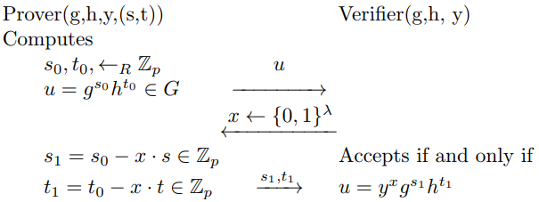
CRYPTOGRAPHIC BACKGROUND
Generalized Schnorr proofs
The protocol is depicted in the diagram below.
Notes:
Verifying the completeness of the protocol is straightforward. We can convert the protocol into a non-interactive protocol that is secure and special honest-verifier zero-knowledge in the random oracle model using the Fiat-Shamir heuristic

Slide 30
IDEA EVALUATION
Notes:
known only to the transaction owner. The latter can use this private key to sign the transaction. This signature can then be verified by the network verifiers which compute the public key from the input and output commitments. Signature verification will pass only if the transaction balance is preserved.
Providing this balance proof, however, requires the transaction to explicitly show which input commitments have been utilized in the transaction, breaking the privacy of the transaction’s history.
CT also employs range proofs to convince the verifier that the transaction outputs are not negative and there will be no value overflow.

Slide 31
IDEA EVALUATION
Notes:
Let us assume transaction spends Nold input coins (cI1, . . . , cNold ) and outputs Nnew coins (cO1, . . . , cONnew ). All coins are of the form C = g sh v where v is the coin’s hidden value and s is its unique serial number. For all Nold input coins the transaction owner first generates separate Σ-proofs (one out of many proofs) which will prove that each spend is valid. Then, let us see how the transaction owner can provide a transaction balance proof with help of these provided Σ-proofs.
We will describe the Σ-proofs in details in section 4.3, but the important thing to observe is that each such proof already contains information hiding the coin’s committed value.
This special value provided in the proof transcript is composed as zd = vxn − Pn−1 k=0 ρkx k which is indeed the blinded version of the transaction value v.

Slide 32
IDEA EVALUATION
After relevant modifications in the original Σ-protocol we can also explicitly reveal the commitments of these blinding factors ρk as Com(0, ρk)
Notes:
So we can consider that the one out of many proofs provided for the Nold input coins incorporate the following values

Slide 33
IDEA EVALUATION
Now one can observe that each verifier can perform the following computations
x is the challenge parameter generated for the non-interactive one out of many (Σ) protocols.
Notes:
Later, we will discuss how the prover can generate a single challenge value x for multiple Σ proofs

Slide 34
IDEA EVALUATION
The verifier can compute
If the balance equation holds, then the value A/B will be a valid public key of the form

Slide 35
IDEA EVALUATION
Now it becomes evident that, along with the Σ-proofs, the prover has to additionally prove the knowledge of the exponent value
Notes:
To do so, the transaction owner can just sign the transaction with the private key (so1 + · · · + soNnew )x n and all verifiers will be able to check if the transaction balance is preserved or not without seeing any information about the input coin origins.

Slide 36
IDEA EVALUATION
Insecured!
Notes:
Unfortunately, without additional measures this approach is insecure. The problem is that coin values v used as a the blinding factor for the commitment are from the small range such as [0, 264 − 1]. As the coin serial number s is revealed during the spend to prevent double spending, one can take the revealed value s and then brute-force over all values v, which are used as the opening of the commitment, to identify the original coin. As one can easily identify both the spent coin and its hidden value this way, transaction privacy is broken.

Slide 37
CONFIDENTIAL PAYMENT HIDING TRANSACTION VALUES AND ORIGINS
Notes:
In Lelantus, we will exploit coins of the form C = Comm(S; V, R) = g Sh V 1 h R 2 where g, h1, h2 are group generators orthogonal to each other, S is the coin serial number , V is the coin value and R is an extra random blinding value. Here the component h R 2 will ensure that it will be computationally unfeasible to identify the commitment given both the values S and V .

Slide 38
CONFIDENTIAL PAYMENT HIDING TRANSACTION VALUES AND ORIGINS
Each transaction will be comprised of corresponding spend descriptions, output descriptions and the transaction balance proof.

Slide 39
CONFIDENTIAL PAYMENT HIDING TRANSACTION VALUES AND ORIGINS
Notes:
Next, we will describe step-by-step the following cryptographic primitives. (a) Σ-proof for doubleblinded commitment opening to 0, (b) zero-knowledge balance proof and (c) Bulletproof for doubleblinded commitments. These building blocks are necessarily enough to compose the proof described above.

Slide 40
CONFIDENTIAL PAYMENT HIDING TRANSACTION VALUES AND ORIGINS
Σ-Protocol for One out of N Double-Blinded Commitments Opening to 0
Notes:
Next, we will describe step-by-step the following cryptographic primitives. (a) Σ-proof for doubleblinded commitment opening to 0, (b) zero-knowledge balance proof and (c) Bulletproof for doubleblinded commitments. These building blocks are necessarily enough to compose the proof described above.

Slide 41
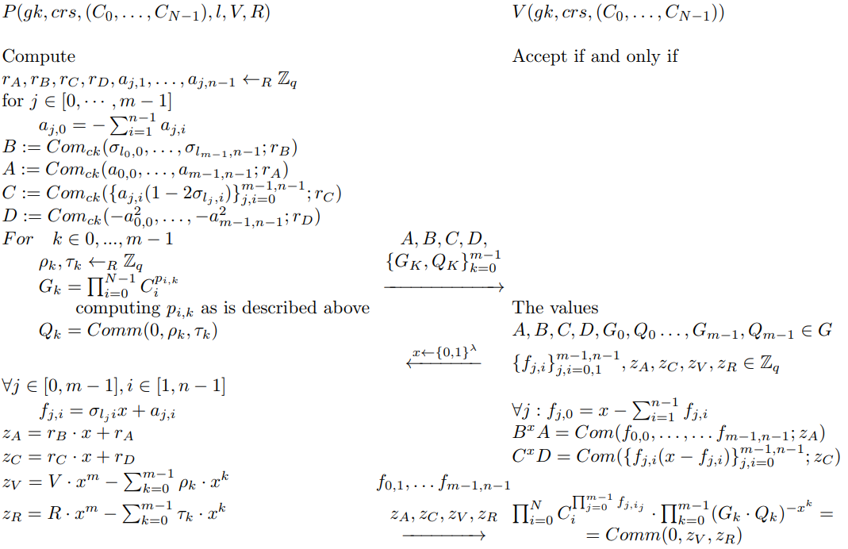
Notes:
Our protocol differs from the original protocol described in [3] in a few different ways. First, it exploits double-blinded commitments, and thus the transcript reveals two different values zV and zR for the two random values used in the commitment. Next, instead of revealing the values Gk as a product of QN−1 i=0 C pi,k i · Comm(0, ρk, τk), we split this product and explicitly reveal a pairs of values Gk = QN−1 i=0 C pi,k i and Qk = Comm(0, ρk, τk). The Qk values are instrumental for verifying the transaction balance proof

Slide 42
CONFIDENTIAL PAYMENT HIDING TRANSACTION VALUES AND ORIGINS
Balance Proof for Transactions with Multiple Spend and Output Transfers

Slide 43
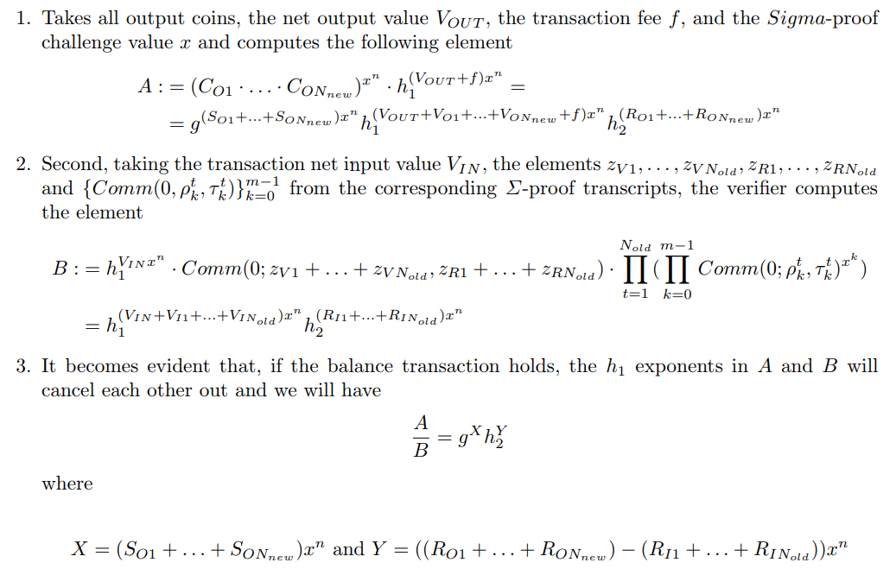
Notes:
Observe that in order to complete the balance proof, it is sufficient for the prover to provide a generalized Schnorr proof of knowledge of the exponent values X and Y described above which he just attaches to the transaction along with the corresponding Σ-proofs for spends and Bulletproofs for outputs.

Slide 44
Thank you

